Slide 1
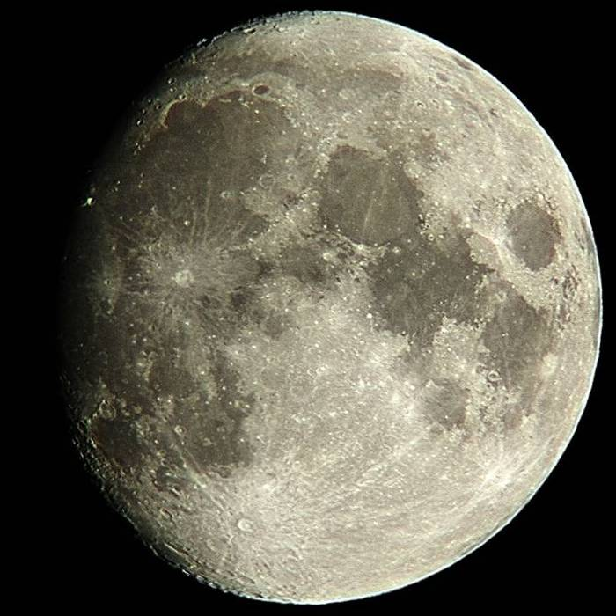
LUNAR MADNESS
&
PLANETARY THRILLS
The Lunar City of
WALLWERK
Richard Orr
December 16, 2004

Slide 2
“We see nothing naively – all perception is a dialogue between the seer and the seen, and depends as much on what you are looking for as what you are looking at.”
Timothy Ferris – “Seeing in the Dark”

Slide 3
The Moon of 1822
Today amateur astronomers see the moon through the eyes of 21st century science
Astronomers of 1822 visualized a moon whose surface features changed, had areas of vegetation (forests) and quite possibly the existence of an intelligent race of Selenites
The hunt for evidence of the Selenites was a worthy goal for astronomers of 1822
If one looks hard enough for something he wished to find; find it he will

Slide 4
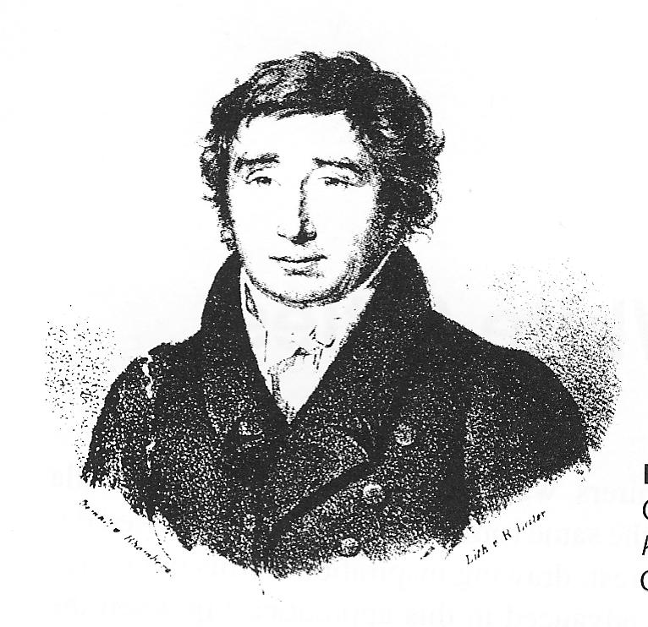
Franz von Paula Gruithuisen was a well respected Bavarian. A Doctor of Medicine and a University Instructor that taught not only medical topics but physics, chemistry, zoology, and anthropology. He was also a well respected and keen moon observer. He is remembered today as the originator of the impact theory of lunar crater formation.
Notes:
[Greet – hi – zen]

Slide 5
In the early hours of July 12, 1822 using his 2.4” refractor at 90x while viewing the last quarter moon he first spotted the fable city of Wallwerk. He was so overpowered by emotion that his hands trembled too much for him to make a drawing.
“At first sight of this object I fancied I was looking down from the height of a steep mountain, through all the seething ocean of the air, and had the birds-eye perspective of a city before me.”
The Wallwerk had a main wall 5 miles long that ran exactly from north to south. Short parallel walls “like the veins of an alder or a rose-leaf” come off of it at exactly 45 & 90 degree angles. In addition, the city stood exactly in the meridian of nutation of the moon’s axis. No doubt about it -- this was the work of intelligent Selenites.
Notes:
The most famous of the lunar cities but there were many others

Slide 6
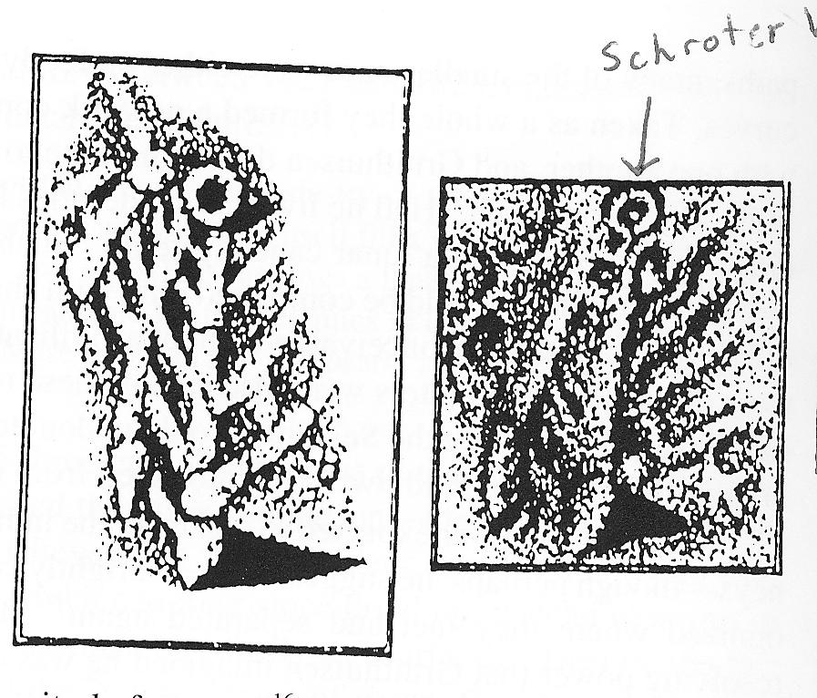
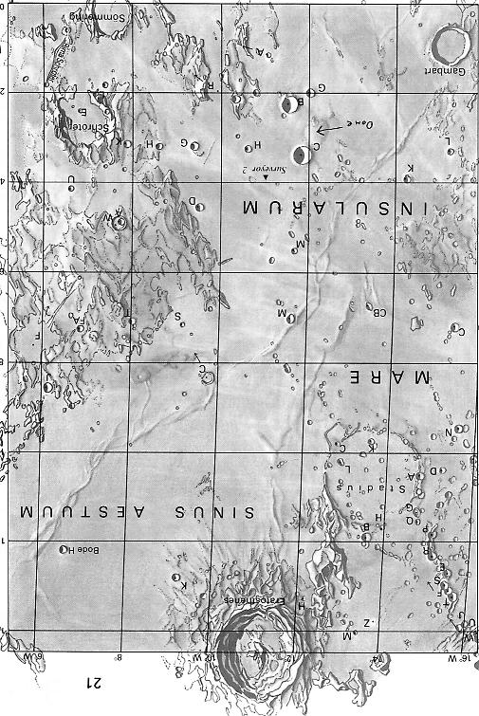
Gruithuisen’s
First Drawing of Wallwerk
October 23, 1822
Gruithuisen’s, drawing showing the STAR TEMPLE (because of this structure that the Selenites were likely star-worshippers)
Rukl Atlas
Map 32 (in part)
Notes:
In years to come active imaginations put in roads and tree lines

Slide 7
“I saw
The Moon’s white cities, and the opal width
Of her small, glowing lakes, her silver heights
Unvisited with dew of vagrant cloud.
And the unsounded, undescended depth of
Her black hollows, Nay – the hum of men
Or other things talkin in unknown tongue
And notes of busy Life in distant worlds”
Alfred Tennyson (1824?) – Armageddon (in part)

Slide 8
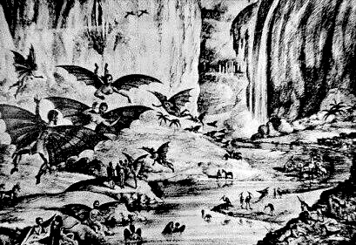

Slide 9
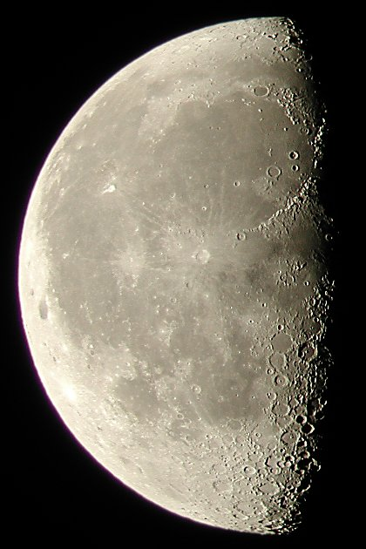
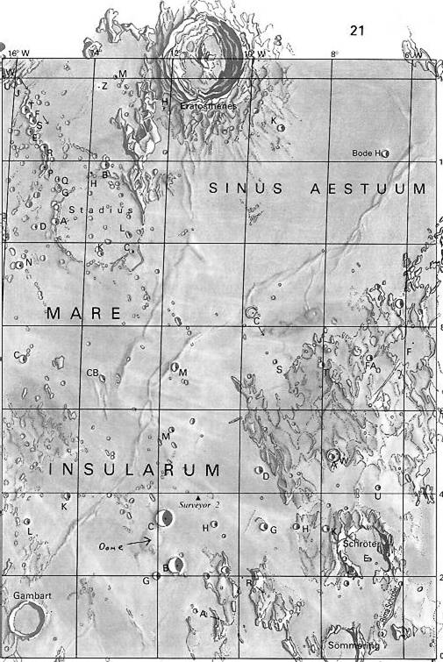
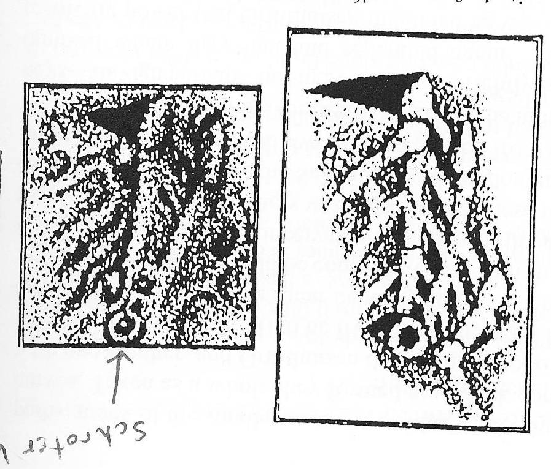
Notes:
Rukl map 32
[ere – tos – theneez]

Slide 10
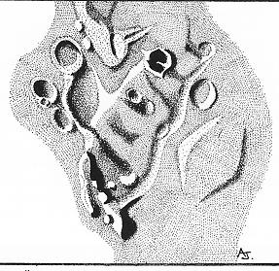
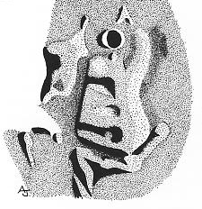
Drawings by Andrew Johnson 8 inch Newtonian (195x)

Slide 11
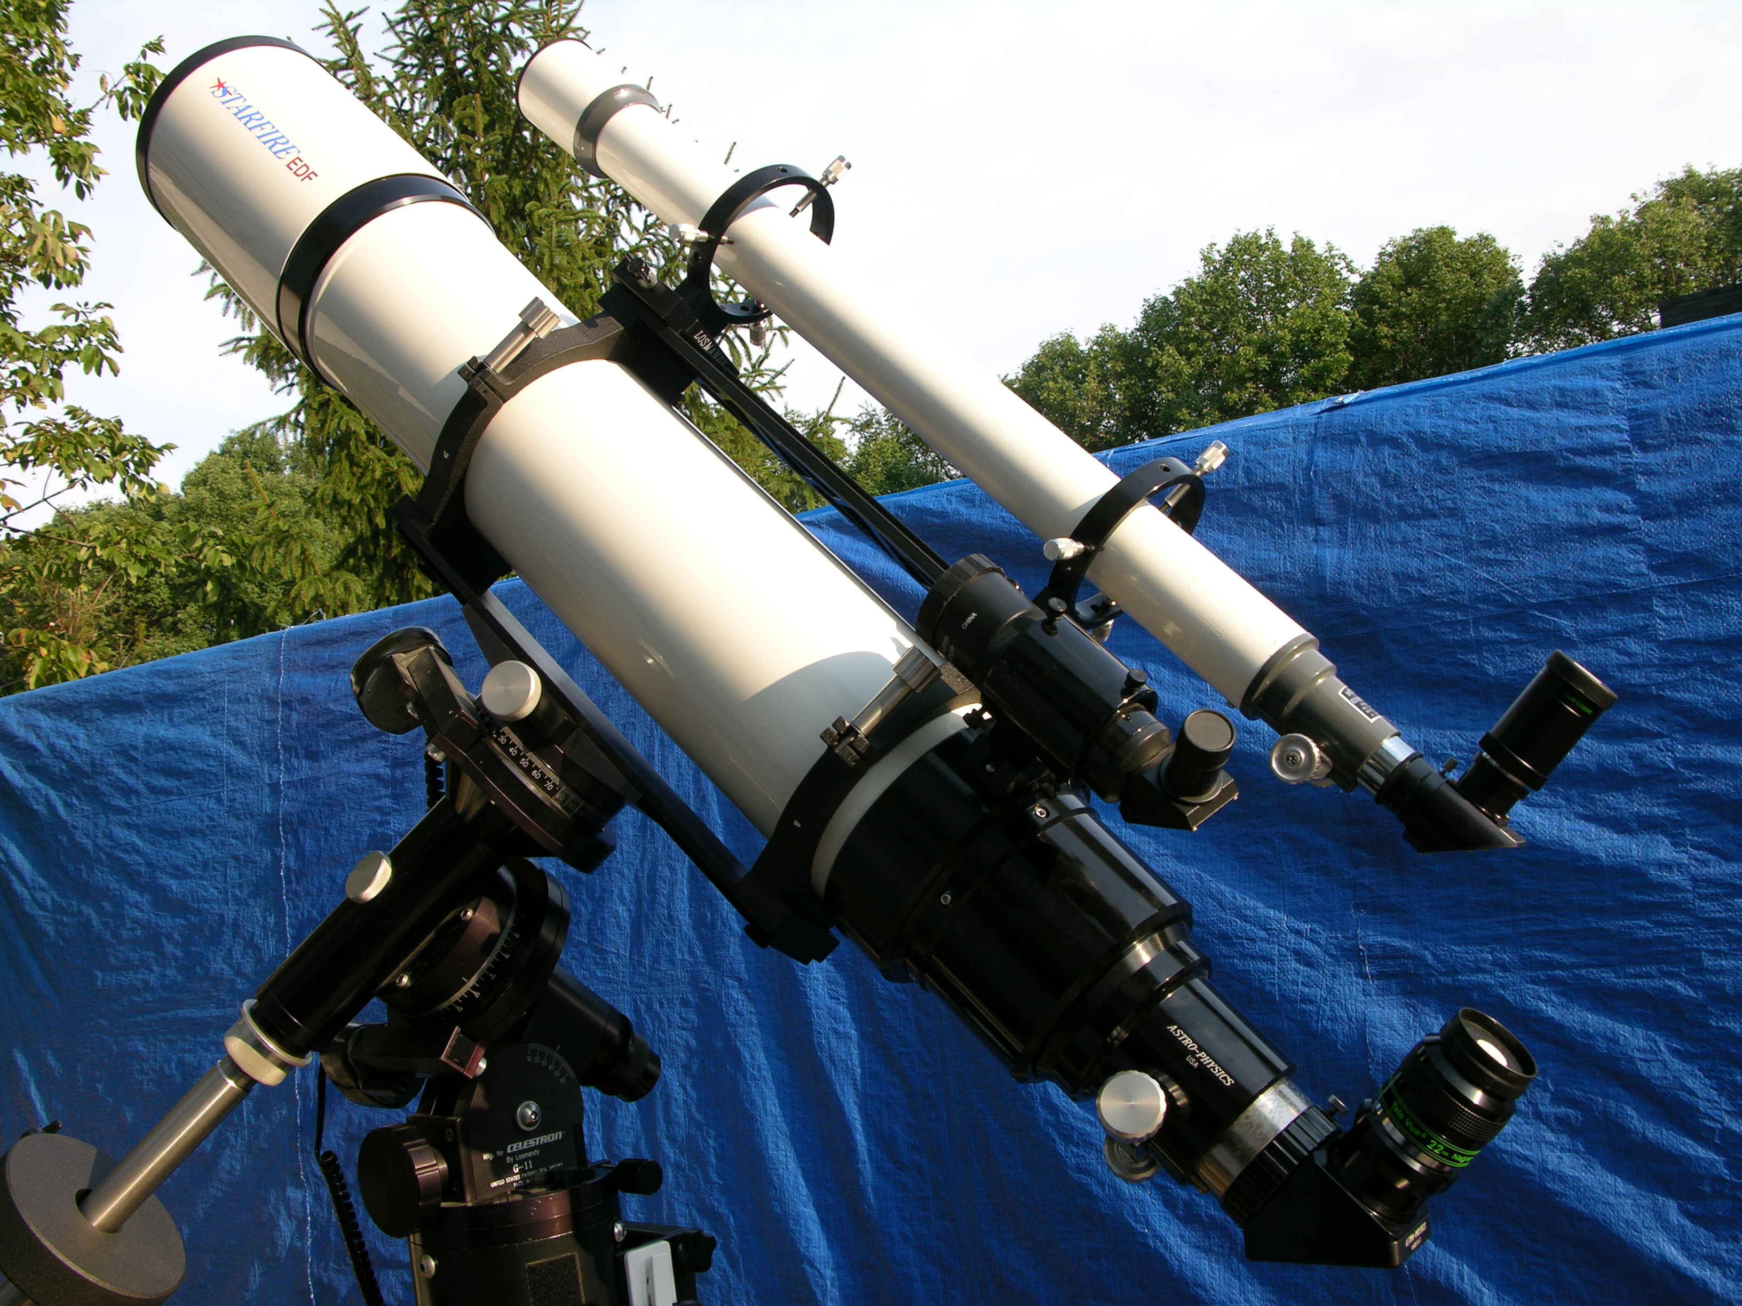
Notes:
Best to use 60mm refractor plus 6mm Radian gives me 91X
Whole moon in eye piece – this is a small object at that power
Fun to let your imagination put you in the shoes of an 1822 observer
I have never seen the star temple – but I always am on the look out for it
Little is known about this part of the moon – its unusual angled hills do stand out

Slide 12
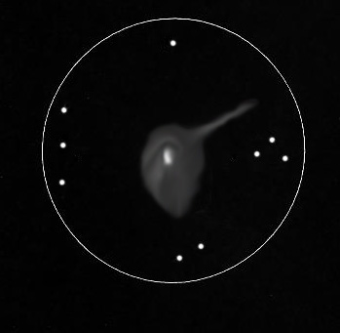
C/2004 Q2
155mm Refractor
50x & 182x
December 15, 2004
0100-0145 hrs UT
Est. Mag = 4.6
FOV = 1.6 degrees

Slide 13
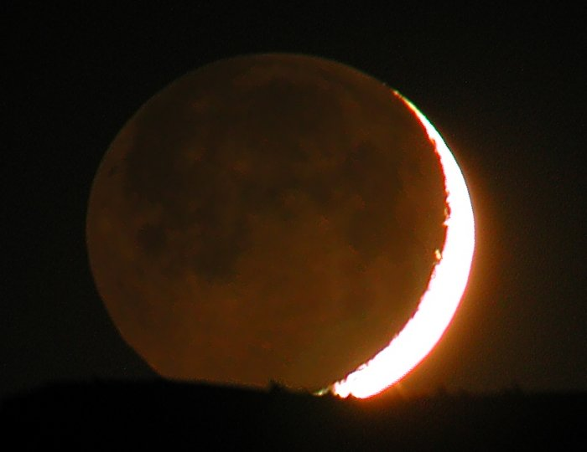
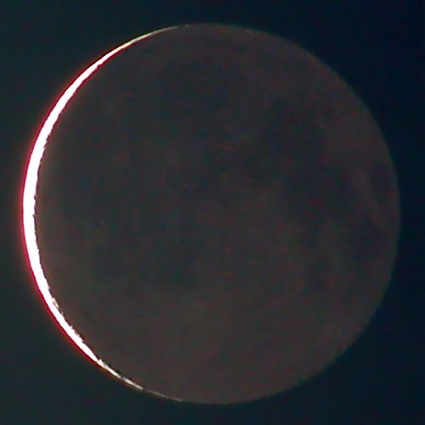
THANKS FOR COMING
Old moon in new moon’s arms
2 days 17 hours
New moon in old moon’s arms
28 days 2 hours
Notes:
Remember the moon is up for viewing 25 days a month

